Slide 1


Server-Driven Video Streaming for Deep Learning Inference
Kuntai Du, Ahsan Pervaiz, Xin Yuan, Aakanksha Chowdhery, Qizheng Zhang, Henry Hoffman, Junchen Jiang
Notes:
Hello, everyone. Today I am going to present the paper "Server-Driven Video Streaming for Deep Learning Inference". I am Kuntai Du, a first-year Ph.D. student from University of Chicago. This is a joint work of me, Ahsan Pervaiz, Xin Yuan, Aakanksha Chowdhery fromm Google, Qizheng Zhang, Henry Hoffman and Junchen Jiang.

Slide 2
Overview
Video analytics is pervasive, but fortunately it allows for aggressive video compression
Only the server-side DNN has sufficient info to guide efficient video compression/streaming
Our idea: Drive video streaming by the real-time feedback from the server-side DNN
➔DNN-Driven Streaming (DDS)
Notes:
Here is a quick overview. First, different from traditional video streaming that cares about the global visual quality, video streaming for analytics enables aggressive compression on those areas that are not relevant to the analytic accuracy.
We argue that only the server-side deep-neural-network (DNN for short) has sufficient information to fully estimate which area should be compressed in real-time.
Based on this observation, we drive the video streaming protocol by the real-time feedback of server-side DNN. In other word, we advocate for a new approach for streaming, called DNN-Driven Streaming.

Slide 3
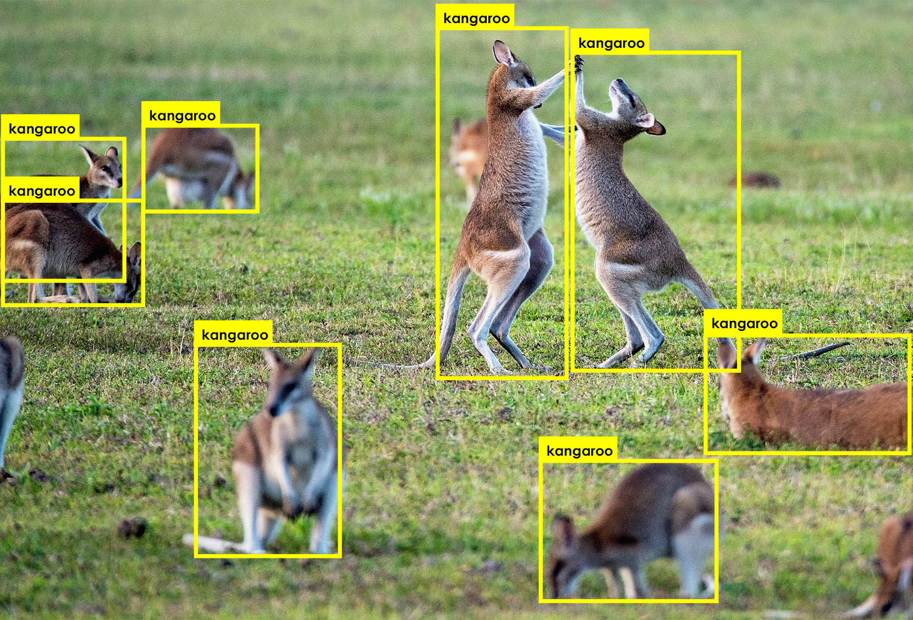
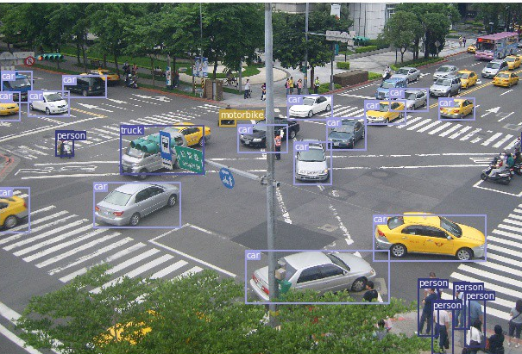
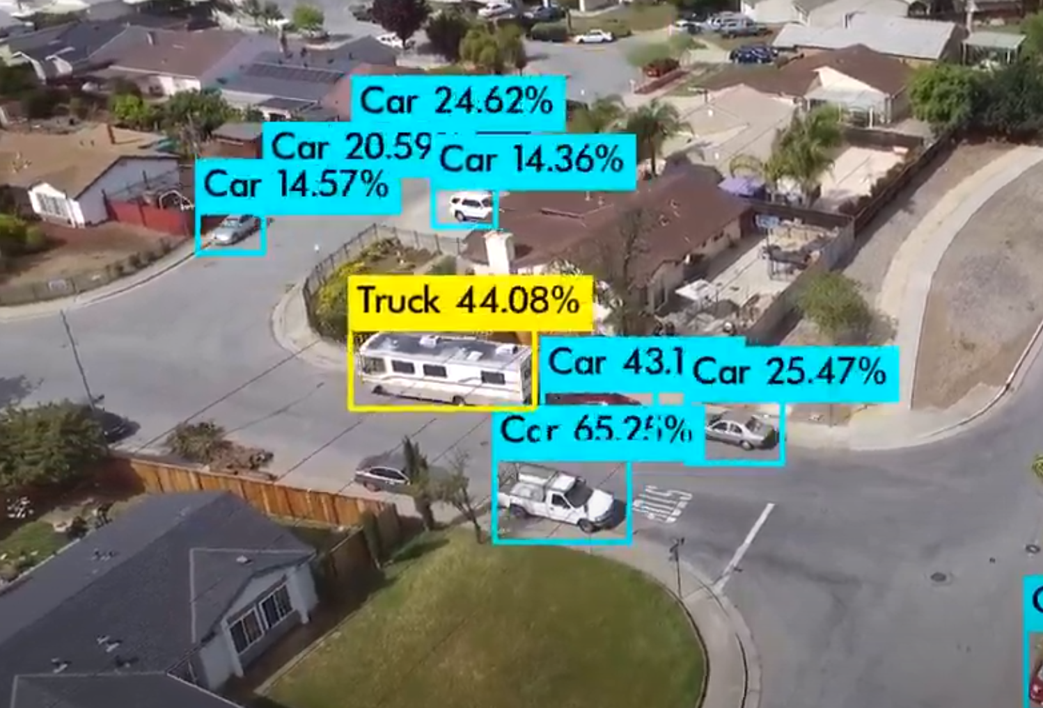
Video analytics become more and more pervasive
Wild-life camera
Learn about the habit of animals
Traffic camera
Monitor the traffic condition
Drone camera
Estimate the number of cars
Our goal: Scale out video analytics.
Notes:
Nowadays, DNN-based video analytics becomes more and more pervasive. For example, people deploy wild-life camera and run analytics to learn about the habits of wild animals.
On the street, people deploy traffic camera and run analytics to monitor the current traffic condition and generate valuable insight.
Last but not least, people also use drone and run analytics for multiple purposes.

Slide 4
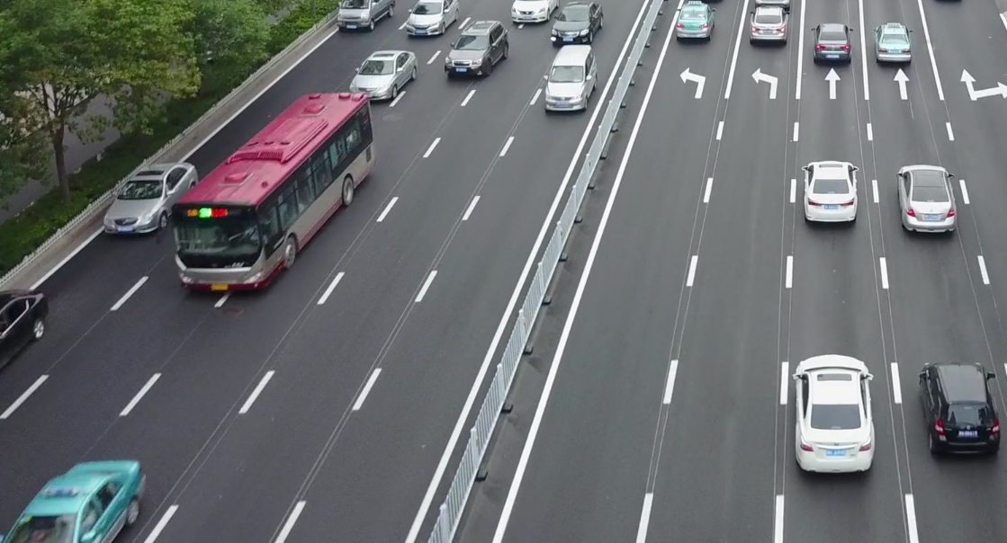
Video needs to be streamed out for accurate analytics
Analyzed by camera locally
Analyzed by a GPU-equipped server
missed objects
detected objects
Cheap model output
(SSD-MobileNet-v2)
Expensive model output
(FasterRCNN-ResNet101)
Limited by camera-side compute power, the camera’s local inference is inaccurate.
We need to stream the video to the server for accurate inference.

Slide 5
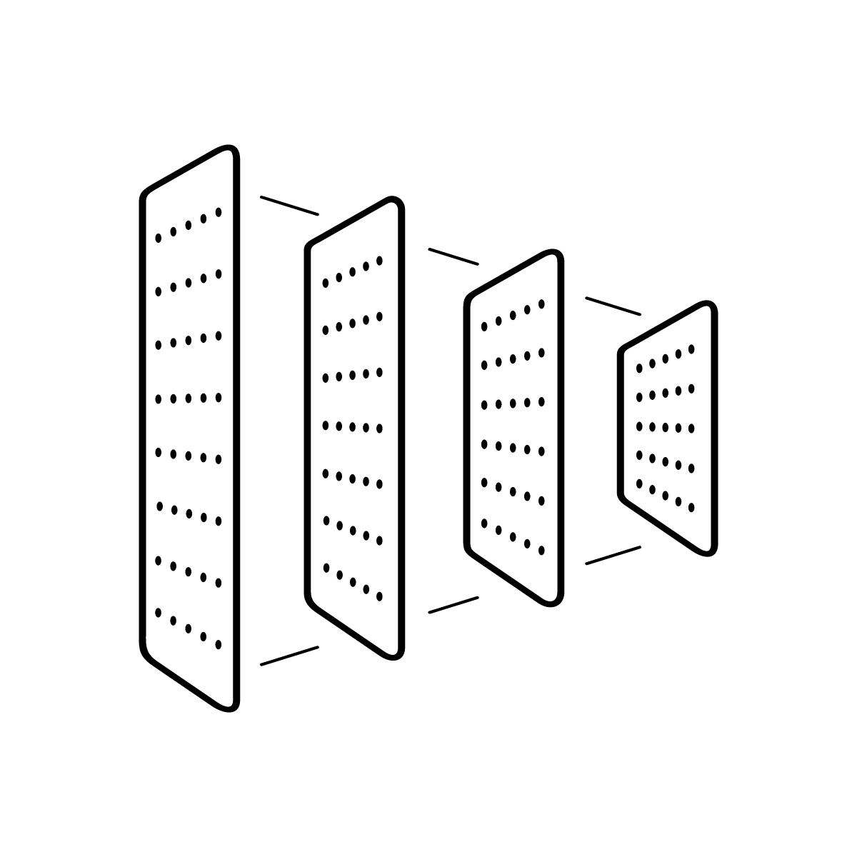



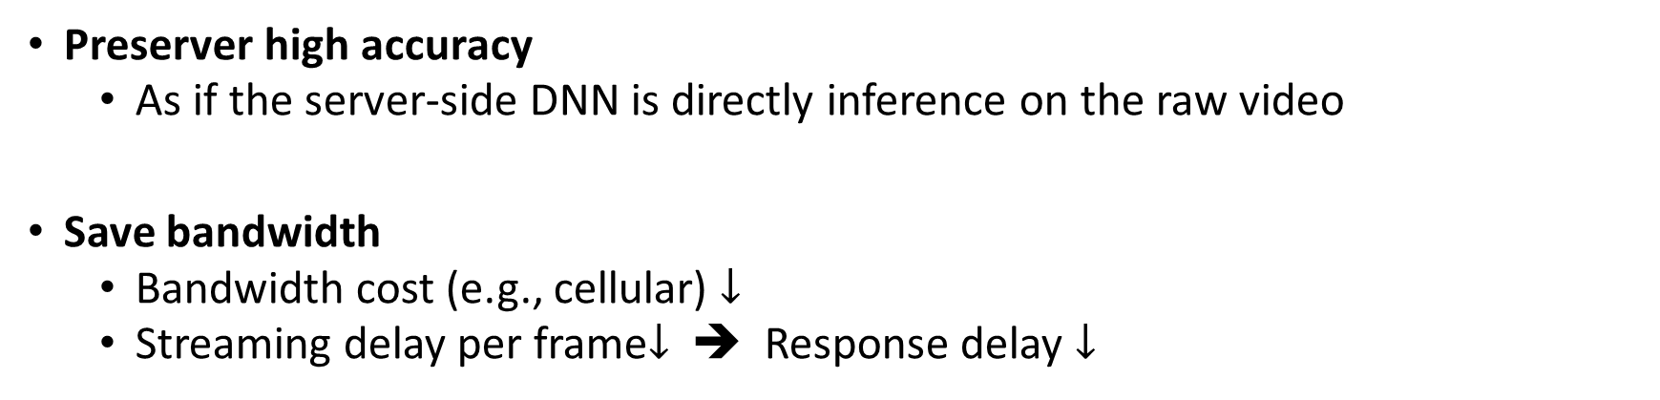
Design goals of video streaming protocol
Network
Camera
Server-side DNN
Preserver high accuracy
As if the server-side DNN is directly inference on the raw video
Save bandwidth
Bandwidth cost (e.g., cellular) $↓$
Streaming delay per frame$↓$ ➔ Response delay $↓$

Slide 6

Bandwidth saving opportunity: aggressive compression
Network
Network
Video server
Human viewer
Camera
Server-side DNN
Video analytics enables aggressive compression on non-object pixels.

Slide 7
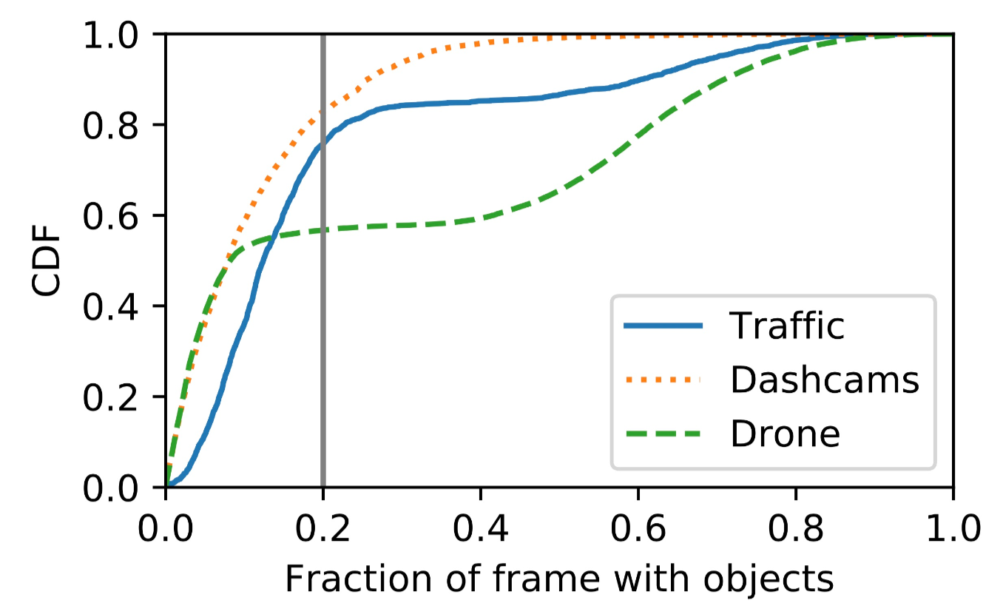
Potential bandwidth savings
Objects only occupy 20% area of the
whole frame in over 50% to 80% cases.
We can compress over 80% pixels in the video without hurting accuracy!

Slide 8
Potential bandwidth savings
Objects only occupy 20% area of the
whole frame in over 50% to 80% cases.
We can compress 80+% pixels without hurting accuracy!

Slide 9
Previous work type 1: Camera-side heuristics
Network
Missed objects
Camera
Server-side DNN
Missed objects
Camera-side heuristics
Sent by camera-side heuristics
Ideal
The camera-side heuristics may miss many objects which will never be recovered by the server DNN.

Slide 10
Previous work type A: Camera-side-heuristics driven
Jetson TX2: 500$ ➔ SSD MobileNet v2 ~12FPS

Slide 11
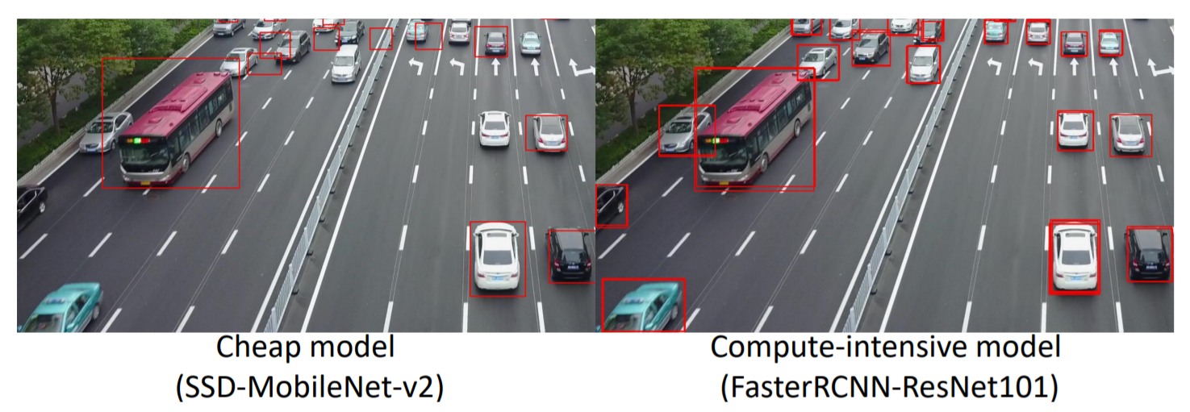
Previous work type 1: Camera-side-heuristics driven
Jetson TX2: 500$ ➔ cheap model ~12FPS

Slide 12

Previous work type 2: Video encoding informed by server DNN
Network
Camera
Server-side DNN
Trees, non-object
Video codec configuration
Street, non-object
Video codec encode
Video sent by these methods
Ideal
These methods can stream all objects, but…
1. They pay too much bandwidth on non-object pixels
2. They need several minutes to adapt to new content
So they cannot react to real-time video content.

Slide 13
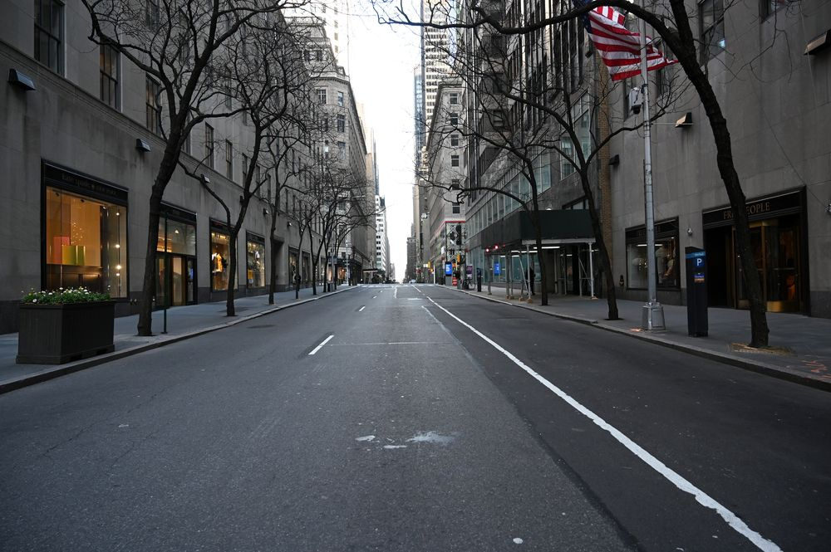
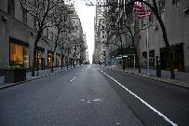

Why real-time content matters?
Several minutes later
0 Accuracy!

Slide 14
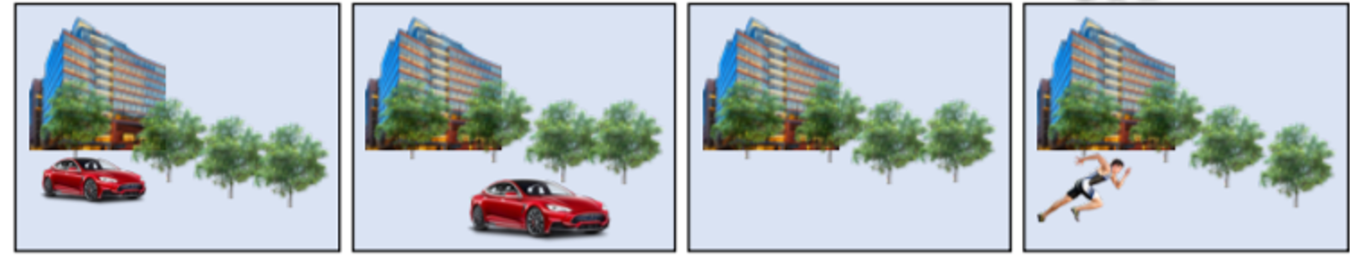
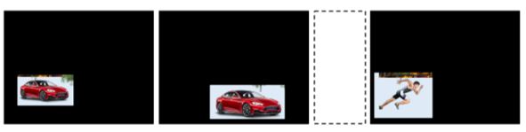
Previous work type 2: Uniform-quality streamingWhy real-tiem
The video these methods streams
The video that is ideal

Slide 15
Example 1: Vigil will miss objects

Slide 16
Example 2: EAAR will send nearly everything to the server
Question: what algorithm should we use to pick
high-quality areas?

Slide 17
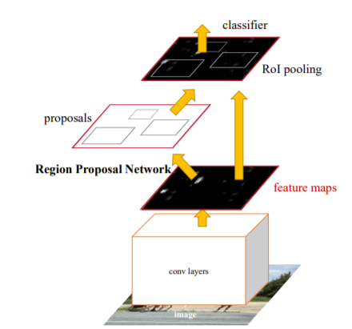
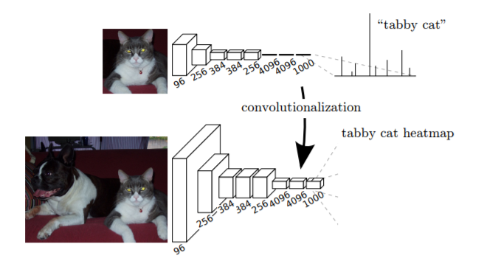
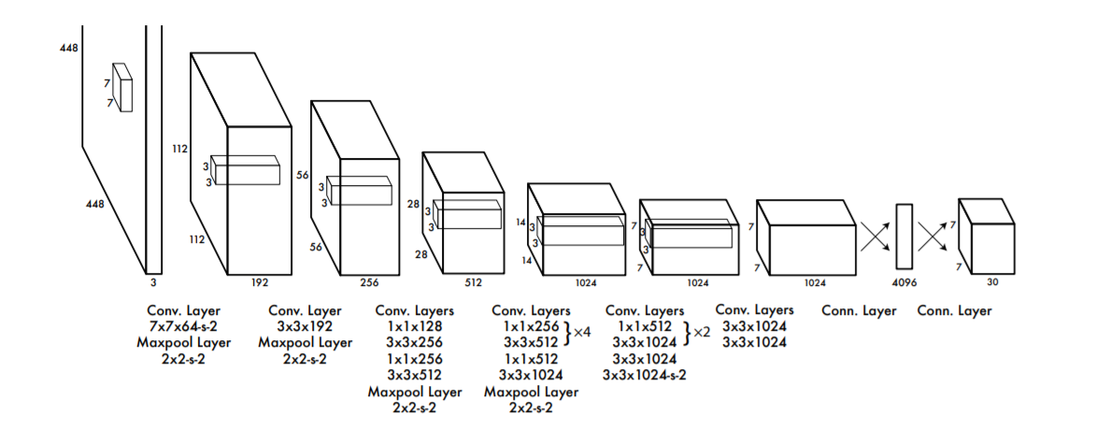
Algorithm requirements of picking high-quality areas
YoLo (object detection)
Faster RCNN (object detection)
FCN (semantic segmentation)
Generalizability:
The algorithm should generalize to different DNN architectures from different video analytic applications.

Slide 18
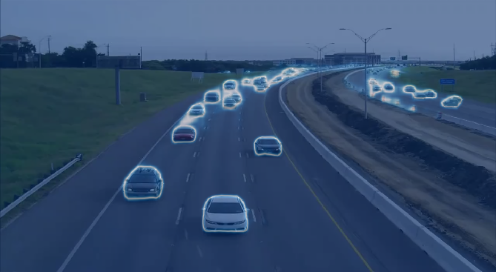
Algorithm requirements of picking high-quality areas
Friendly to video codec:
The areas should be reorganized as regular rectangles

Slide 19
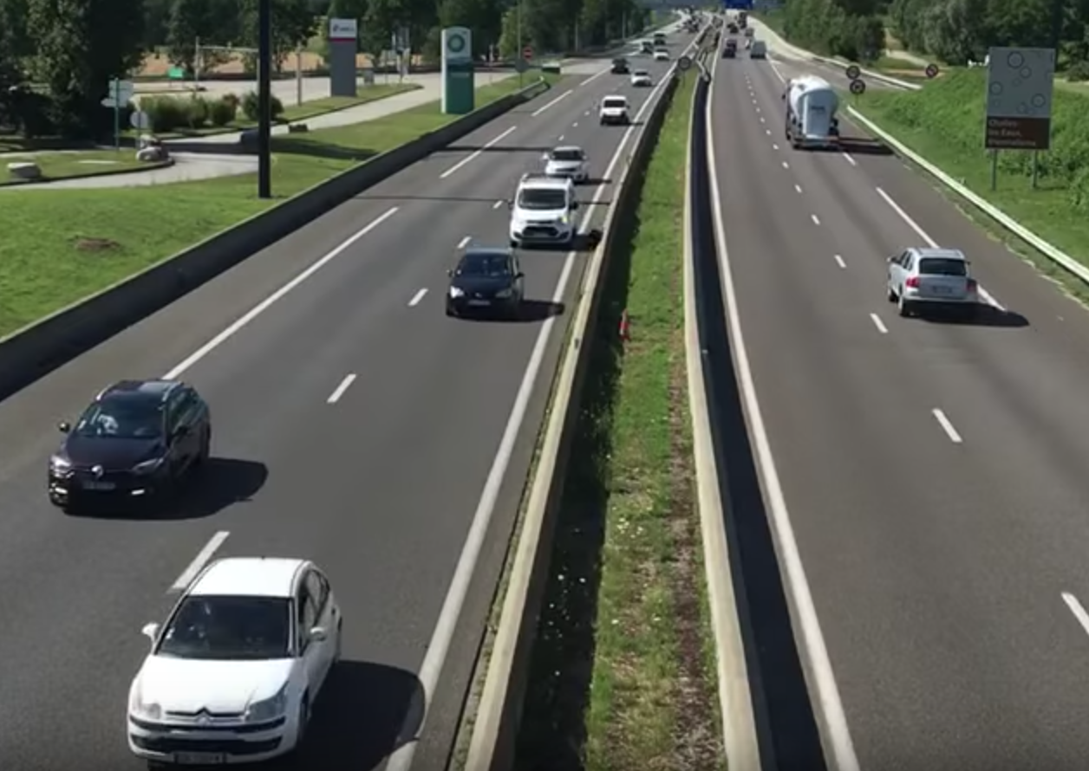
Algorithm requirements of picking high-quality areas
Detection results under low quality
Detection results after encoding blue area in high quality
Efficiency:
High-quality areas should focus on those areas that are almost confidently detected but not.

Slide 20

Challenge. Efficient areas depends on the inference results on current frame, and thus very unpredictable
Camera Field-of-View
Not in Field-of-View, don’t need to be encoded in high quality

Slide 21
Challenge. Efficient areas depends on the inference results on current frame, and thus very unpredictable
Camera Field-of-View
Just enter the Field-of-View, too small to be detected, need to be encoded in high quality

Slide 22
Challenge. Efficient areas depends on the inference results on current frame, and thus very unpredictable
Camera Field-of-View
Large enough to be detected, should not be encoded in high quality anymore.

Slide 23
Challenge. Efficient areas depends on the inference results on current frame, and thus very unpredictable
“Deadlock”:
inference results ➔ Efficient areas ➔ inference results
Solution:
Inference results on low-quality
Propose efficient areas
Accurate inference results

Slide 24
Summary on previous works
Type 1. Camera-side heuristics
Type 2. Server-driven uniform-quality streaming
The camera is lack of compute
Only tune codec parameters of future video
How to react to real-time video content without missing objects?
Miss objects
1. Waste bandwidth on non-object pixels
2. Cannot react to real-time video content

Slide 25
Previous video streaming protocols
Type 1. Camera-side heuristics
Type 2. Video encoding informed by server DNN
The camera is lack of compute
Tune current codec configs base on previous video
1. Waste bandwidth on non-object pixels
Miss objects
2. Cannot react to real-time video content
Low accuracy
High bandwidth consumption
Sub-optimal bandwidth-accuracy trade-off!

Slide 26
Design choices
The video streaming protocol should
(1) be completely driven by the server-side DNN feedback and
(2) react to real-time video content
Why this is difficult? A Chicken egg problem:
Camera needs the server-side feedback of current video to encode current video
See the video first and iterate on how to encode the video

Slide 27
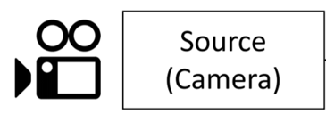
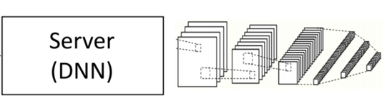
Solution: DNN-Driven Streaming (DDS)
Stream A: passive, low-quality
Stream B: feedback-driven, high quality

Slide 28
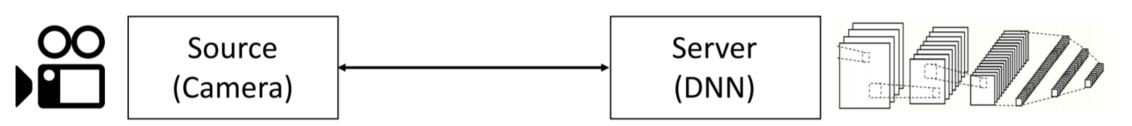
Solution: DNN-Driven Streaming (DDS)
Stream A
DNN inference
Encode in low quality
Inference results
Feedback regions

Slide 29
Solution: DNN-Driven Streaming (DDS)
Stream B
Feedback regions
Update inference results
Camera re-encode with high quality
New inference results

Slide 30
Solution: iterative workflow
We grant the server another chance to
iterate on how previous video should be streamed!

Slide 31
DNN-Driven Streaming (DDS): iterative workflow
BLUR the image
Raw video segment
Stream A: passive, low-quality
Network
Camera
Server
Server-side DNN
Feedback regions
Inference results
Feedback regions
Feedback regions
Stream B: high quality, driven by regions generated from server-side DNN

Slide 32
Solution: DNN-Driven Streaming (DDS)
Timeline
Camera
Inference results
Low quality
High quality
New
inference results
Feedback regions
Server
DNN Inference
DNN Inference
Timeline

Slide 33

General logic on feedback region generation
Generate regions that may contain objects
Eliminate regions that overlap with high-confidence inference results
Encode remaining regions in codec-friendly manner
Already confident
Drop?

Slide 34
Example: object detection
Generate all regions that may contain objects
Eliminate regions that overlap with high-confidence inference results
Encode remaining regions in codec-friendly manner
Generated from the intermediate output of DNN
DNN is already confident
Faster-RCNN: region proposal network output with
high confidence score
YoLo: detection bounding boxes with the sum of the
score of all non-background classes over a threshold

Slide 35
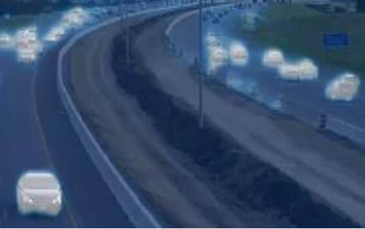

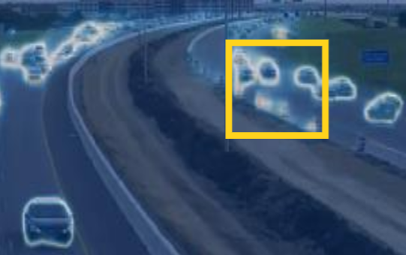
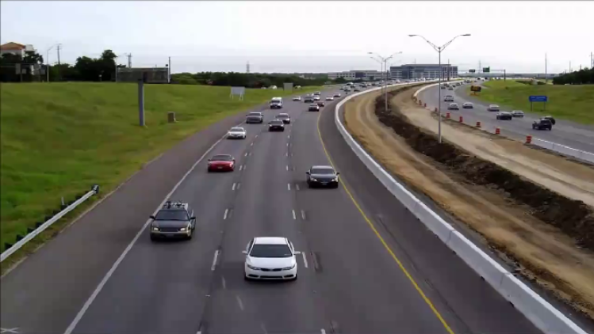
Example: semantic segmentation
Generate all regions that may contain objects
Eliminate regions that overlap with high-confidence inference results
Encode remaining regions in codec-friendly manner
Label each pixel with the sum of the probability of all non-background classes. “Brighter” the pixel, higher the probability
DNN is already confident
DDS find the regions where the DNN is indecisive.

Slide 36
Comparing DDS with other region-based streaming
DDS
Vigil[1]
Miss small objects
EAAR[2]
High-quality regions sent to the server
Can be detected in low quality
Segment by segment
(more temporal compression)
Frame by frame
Frame by frame
[1]: The Design and Implementation of a Wireless Video Surveillance System, Mobicom ‘15
[2]: Edge Assisted Real-time Object Detection for Mobile Augmented Reality, Mobicom ‘19

Slide 37
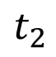
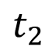
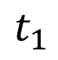
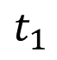
Reduce the response delay of DDS
$$t_{2}$$
0
$$t_{1}$$
Timeline
Camera
$$t_{2}$$
$$t_{1}$$
Low-quality video
High-quality video
Update
inference results
Inference results
Server
Timeline
DNN Inference
DNN Inference
While we improve accuracy in the second inference, over 90% results are produced by the first inference and can be returned very quickly.

Slide 38
Evaluation setup
Dataset
We evaluate DDS on 49 videos of various camera types and content genres.
Traffic camera videos, dacham videos (from YouTube), drone videos (from VisDrone[1]), face videos (from sitcom videos), total length: about 20,000 seconds
Three vision tasks (and the servers-side DNN models)
Object detection: FasterRCNN-ResNet101
Semantic segmentation: FCN-ResNet101
Face recognition: InsightFace
[1]: Vision Meets Drones: Past, Present and Future, arXiv preprint

Slide 39
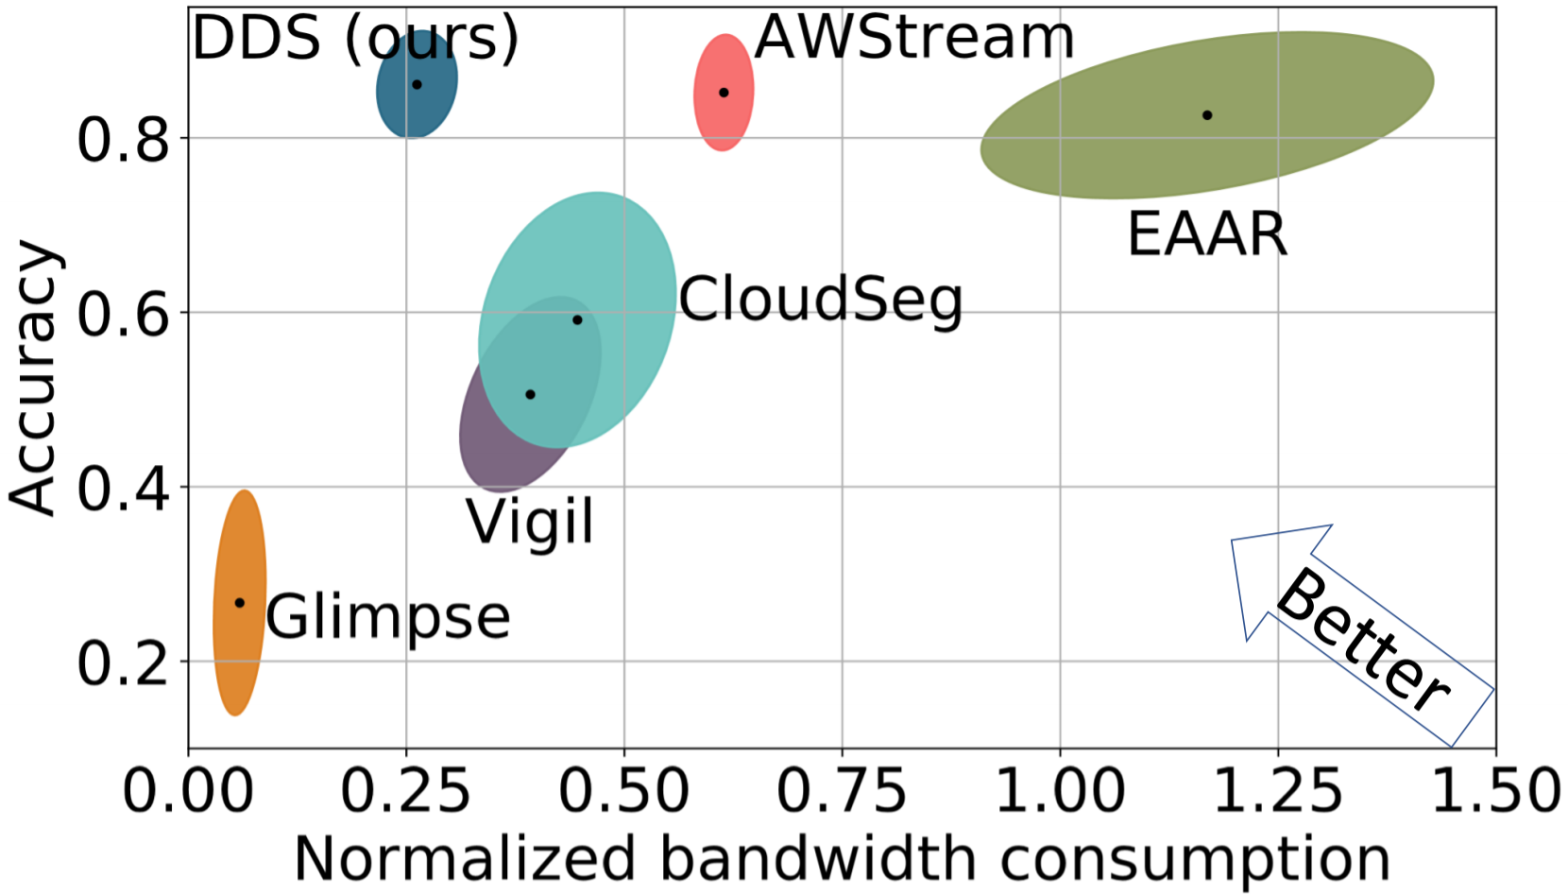
Accuracy vs. bandwidth consumption
Better
DDS can save upto 59% bandwidth and achieve higher accuracy.

Slide 40
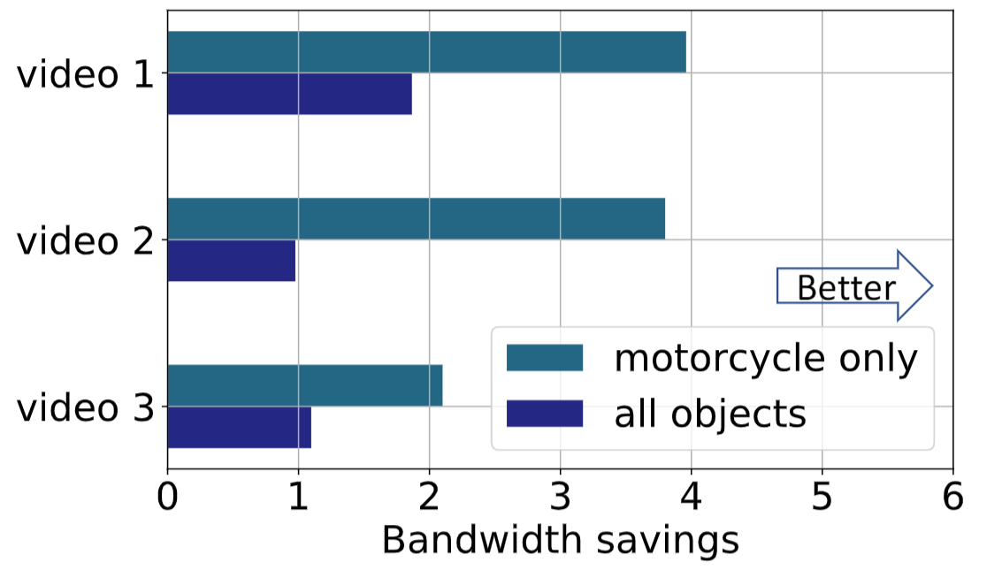
Bandwidth savings vary with videos and queries
In our dataset, bandwidth savings varies from 1-4x in different videos.
DDS achieves 2-4x more bandwidth savings on motorcycle only.

Slide 41
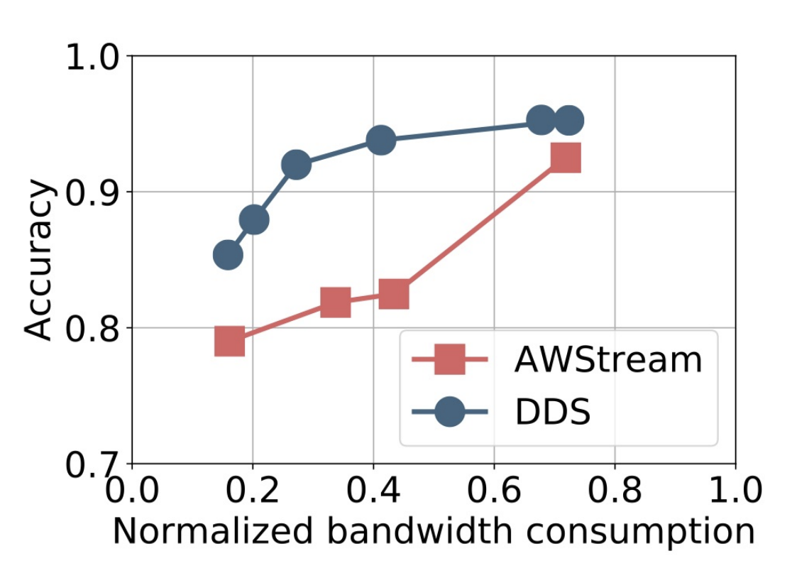
Bandwidth adaptation
DDS can adapt to bandwidth and preserve higher accuracy.

Slide 42
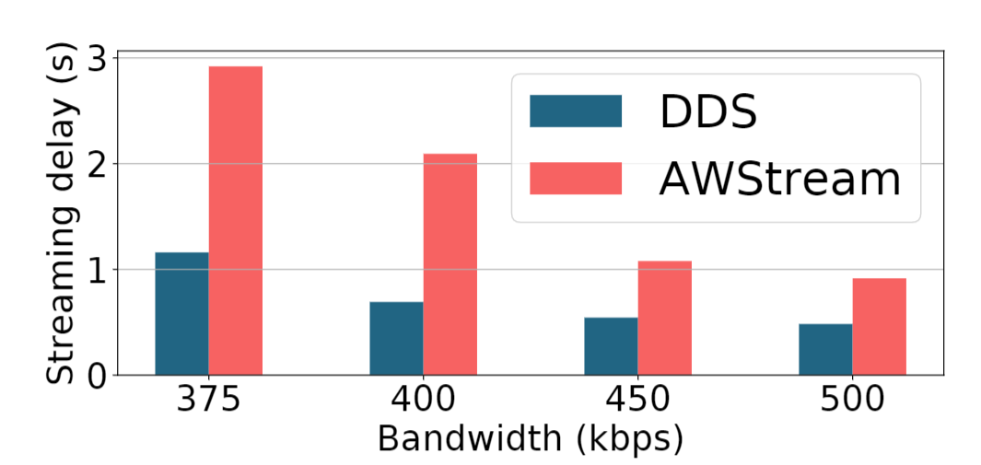
Streaming delay
DDS saves about 50% streaming under various bandwidth.
Notes:
Among all the existing solutions, the conventional wisdom is that, when watching 360 videos, users pay *equal attention* to *all* pixels in the viewport.
However, we found this is actually a myth, and sticking to it will miss many opportunities to save bandwidth!

Slide 43
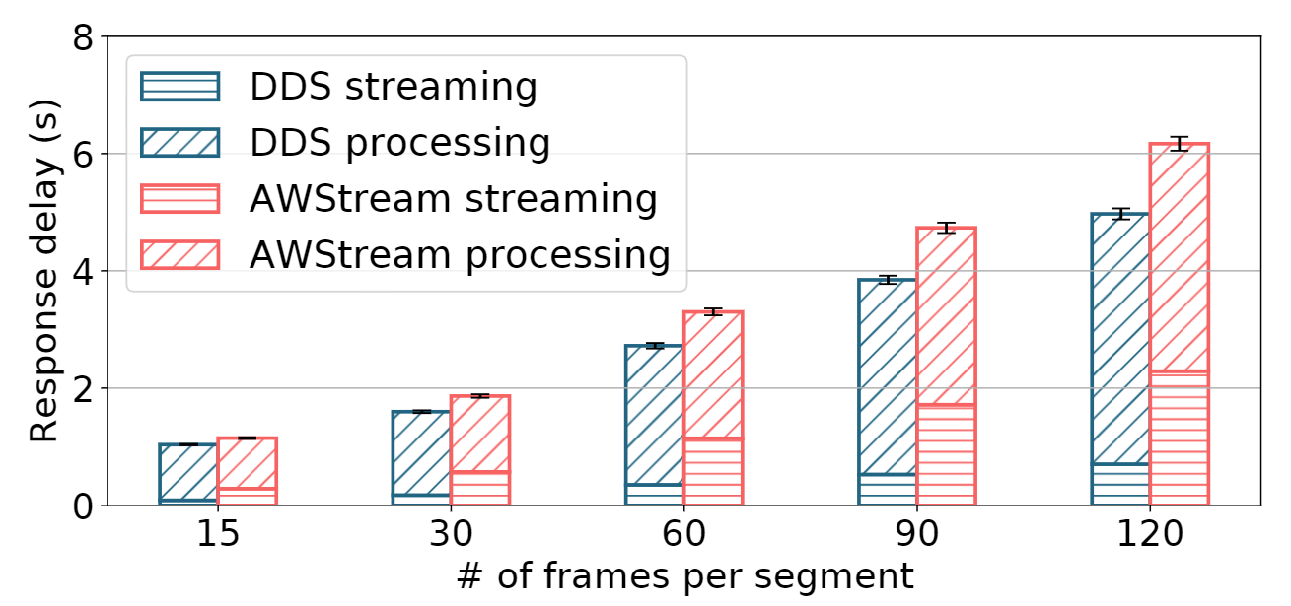
End-to-end delay
The end-to-end delay of DDS is consistently lower than AWStream.

Slide 44
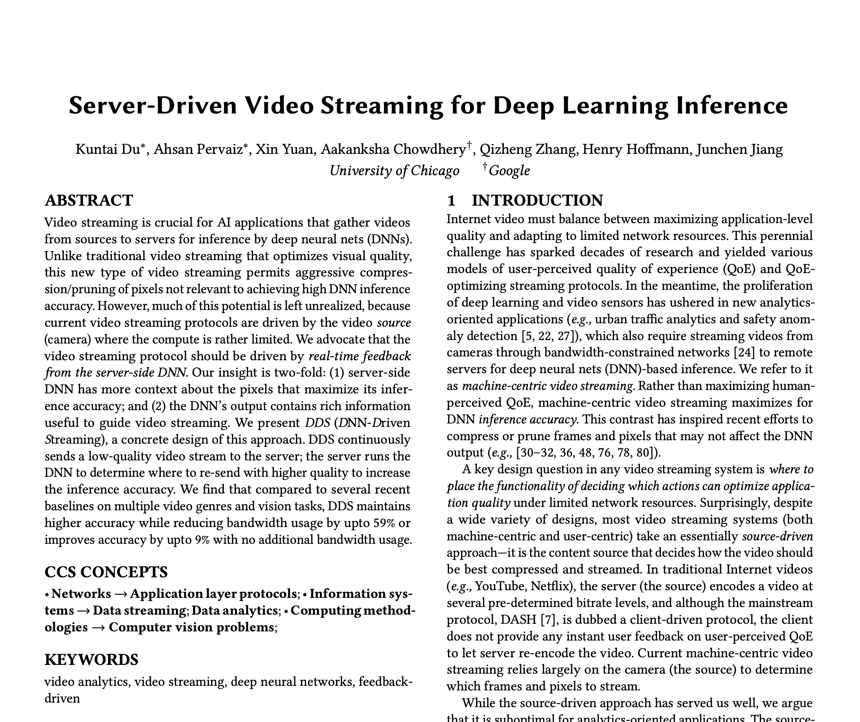
More details in our paper:
Cost-delay-accuracy analysis
Bandwidth adaptation
More design rationales
End-to-end delay analysis
DDS under various network conditions
Parameter sensitivity analysis
Fault tolerance
…

Slide 45
Conclusion
Video streaming for analytics enables aggressive video compression
Only the server-side DNN has sufficient info to accurately guide video streaming
Our contribution: DDS: iterative workflow driven by DNN feedback on real-time content
Results: better bandwidth-accuracy trade-off and lower end-to-end delay
More resources: https://kuntaidu.github.io/aboutme

